Slide 1

The Ethics of Self-Disclosure
Welcome everyone!
Diane Bigler, LCSW, LSCSW
www.dianebiglertraining.com

Slide 2
Learning Objectives and CE Statement
Learning objectives
CE statement
Diane Bigler is a Kansas BSRB Continuing Education Provider (#22-007).
All trainings facilitated by Diane are guaranteed to be accepted as CEU’s by the BSRB.
Comprehend and describe key aspects of therapeutic self-disclosure, including potential benefits and risks.
Examine and articulate key ethical considerations of self-disclosure.
Apply best practices for ethical and therapeutic self-disclosure.

Slide 3
Defining Self-Disclosure
The revelation of personal rather than professional information about the therapist to the client. (Zur et al, 2009)
Anything that is revealed about a therapist verbally, nonverbally, on purpose, by accident, wittingly, or unwittingly, inclusive of information discovered about them from another source. (Bloomgarden & Menuti)
Sharing of personal information by the therapist with the client; it excludes details related to the treatment, the therapist’s credentials, office policies, and emergency contact details (Barnett, 2011).
Research suggests “in reality that therapists generally do disclose” personal information about themselves and their beliefs, and that it happens more often than many would assume (Danzer, 2019).
0 --------1-------- 2 -------- 3 -------- 4 -------- 5 --------- 6 ---------- 7 ----------- 8 ----------- 9 ----------- 10
Self-disclosure is rarely okay Self-disclosure is often okay

Slide 4
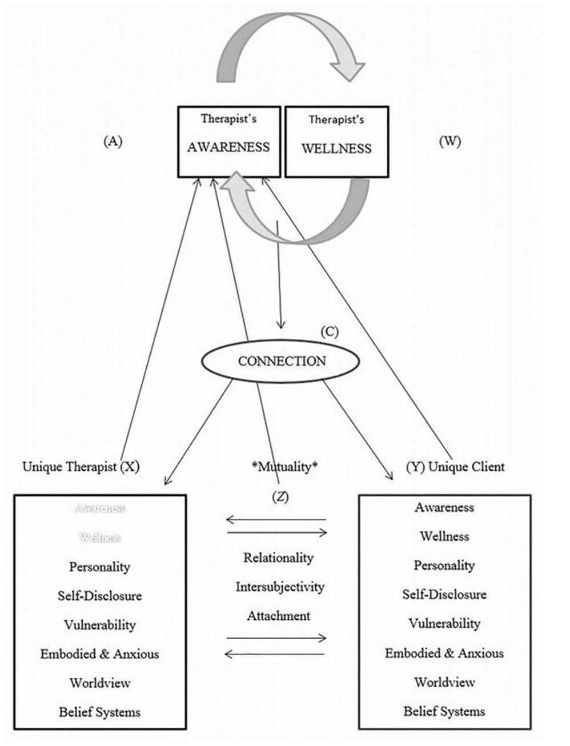
Clinician self-disclosure can blur boundaries, damage a client’s trust, shift the focus of the relationship away from the client, and undermine therapy.
However, handled skillfully, judicious self-disclosure can enhance a client’s sense of reciprocity in the clinical relationship, strengthen the therapeutic alliance, facilitate client trust, contribute to a more collaborative worker-client relationship, provide the client with a powerful role model, demonstrate the universality of human frailty, and normalize the client’s challenges.”
- Frederic Reamer (2011)
Video clip: Managing Disclosures in Therapeutic Relationships
https://youtu.be/1BFkZhsTcik

Slide 5
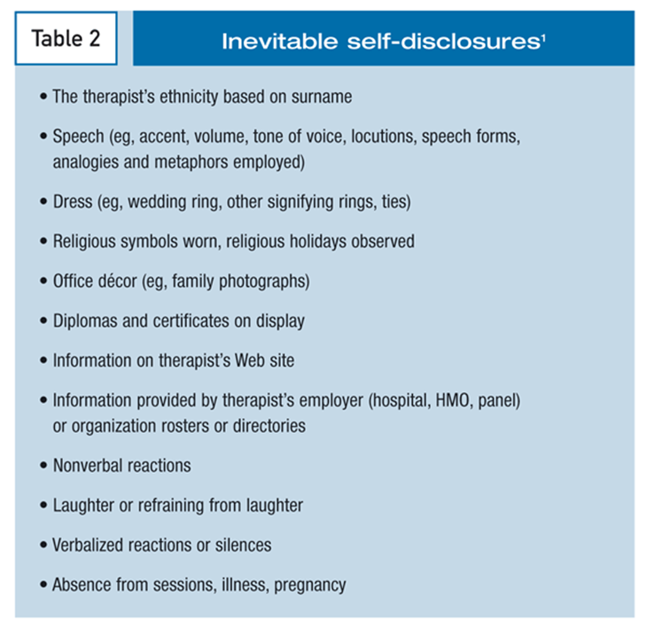
Key Points About Self-Disclosure
The term “therapist self-disclosure” tends to evoke an image of a psychotherapist revealing some deeply personal fact about themself during a therapy session.
In truth, therapist self-disclosure refers to a wide range of psychotherapist behaviors:
  Verbal → Disclosure of fact, style of speaking
  Non-verbal → ??

Slide 6





Matching Exercise:
Types of Self-Disclosure
WORD BANK
A. Deliberate
B. Unavoidable
C. Accidental
D. Inappropriate
E. Client-initiated
Meeting a client while out with your family at a community event.
Gender, age, a distinctive physical characteristic such as a visible tattoo or pregnancy, style of dress, jewelry (i.e. a cross necklace or wedding ring).
A client seeking out clinician family and friend connections, volunteer activity, religious affiliation, political affiliation, community involvement, legal/court documents, personal photo/video postings.
Verbal sharing by clinician of personal information or a specific action, such as placing a family photo in your office.
Clinician discusses their own personal problems and hardships with their clients with no clinical rationale or purpose.

Slide 7
What Do Our Ethics Codes Say?
NASW
1.06 (a-c) Conflicts of Interest
Conflicts of interest that can emerge when social workers disclose personal information to clients, whether for purposes of intimacy and emotional connectedness, personal benefit, altruism, or as a result of unexpected or unanticipated circumstances
ACA
A.2.b. Types of Information Needed
Self-disclosure should only be engaged in when there is an inherent benefit to the client.
AAMFT
1.7 No Furthering of Own Interests
MFT’s do not use their professional relationships w/clients to further their own interests.
No codes reference the term “self-disclosure” specifically.

Slide 8
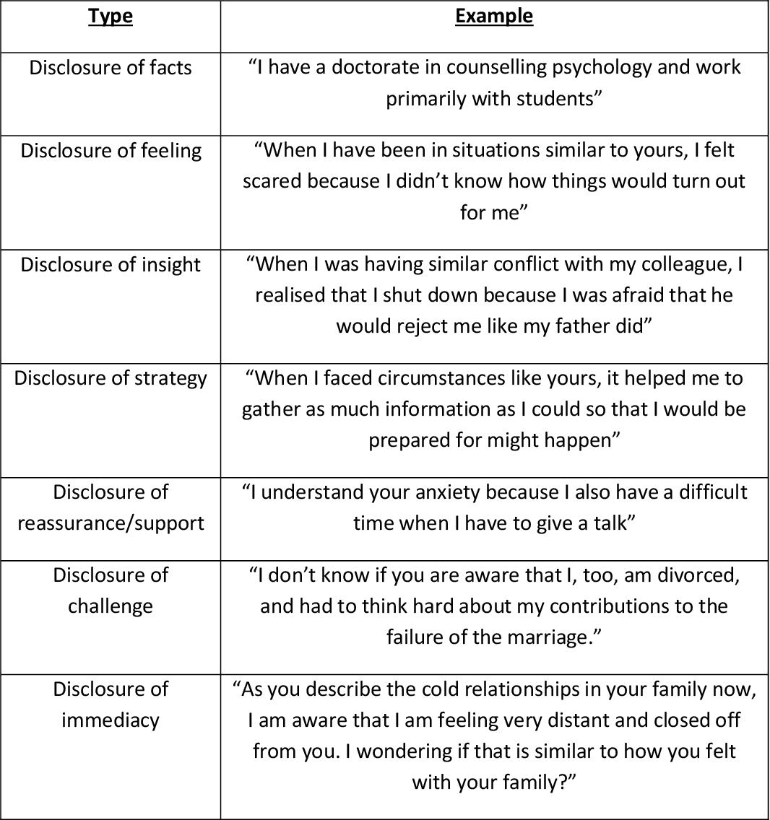
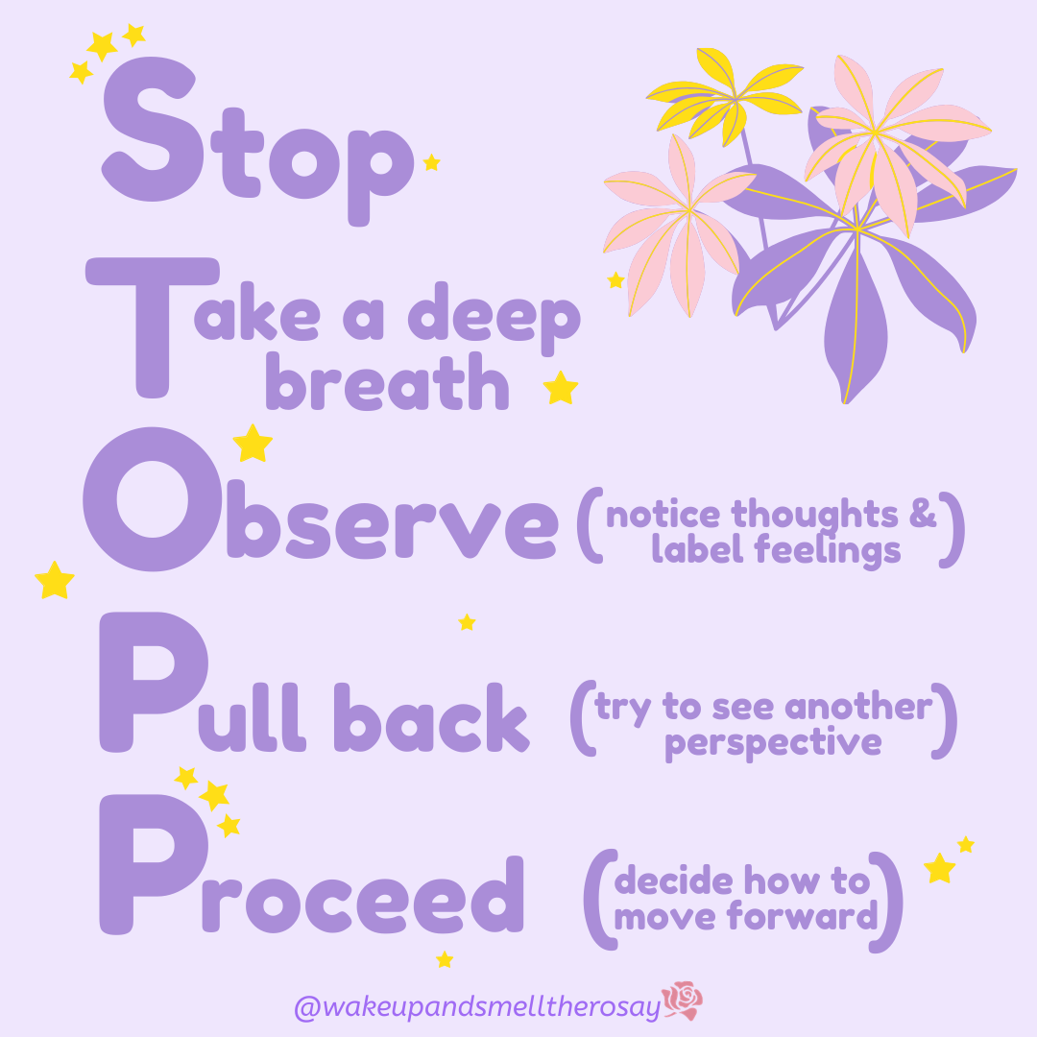
HANDOUTS:
A Cheat Sheet to Self-Disclosure in Therapy,
Online Disclosures

Slide 9
Case Vignette: How Would You Respond?
As a social worker at a family service center, Amanda works with various clients. One of her clients, Susan revealed that her husband had been abusing her physically. Amanda has been empowering and working with Susan on her safety concerns.
At the end of one of their counseling sessions, Susan expressed her amazement at how much Amanda had been able to help her. “You seem to understand me so much,” Susan said. “Have you had personal experience with family violence?” The straightforward question took Amanda by surprise and she was unsure about how to respond. She had, in fact, been in an abusive relationship.

Slide 10
Benefits and Guidelines
Guidelines
The self-disclosure must be for the therapeutic benefit of the client, not the personal need of the clinician.
The disclosure of emotion must contain real emotion.
The clinician must feel comfortable in making the disclosure.
The choice to apply self-disclosure should be under the control of the clinician at the time when it is being considered.
The technique of self-disclosure must align with the larger style of the clinician and his/her authentic way of relating.
Self-disclosure should only be used if the client wants it, if the therapeutic relationship is solid and strong, and if both the clinician and client are able to engage usefully about what is occurring in the treatment at the time of the disclosure.
BENEFITS
The “dyadic effect”: openness from the clinician supports openness from the client.
Contributes an experiential component to the corrective emotional experience, improving emotional attunement using mirroring and responding.
Provides behavioral and social feedback that helps the client see him/herself more clearly and situate him/herself in relation to others.
Models effective affect management and interpersonal effectiveness skills.

Slide 11
Risks of Self-Disclosure
3. Disclosing for personal reasons:
When used by the therapist to get things off their chest, self-disclosure may serve their personal agenda, not their client’s.
4. Lack of attunement:
When communication from the therapist is not attuned to what the client is saying, it can leave the latter feeling that the therapeutic relationship and process are unfolding or unproductive.
5. Disclosure as a competency:
Disclosure should be seen as an intervention, and failure to perform it well suggests a lack of skill or poor competency. Unless it serves the client’s needs at that time, it may be unhelpful or even harmful.
1. Lack of attentiveness:
Overly intimate self-disclosure can interfere with the therapy process, potentially leaving clients overwhelmed.
2. Too frequent:
When disclosure is too frequent, it can become ineffective and damage clarity surrounding role boundaries.
HANDOUT:
Let’s Practice

Slide 12
Situations Where SD May Be Appropriate
When the client believes he/she is the only one to have experienced something.
When the client has been struggling to achieve a particular goal and seems to be losing confidence.
When your clinical ability is diminished or affected by illness, pre-occupation with thoughts or worries, or other internal or external factors – but only if the client’s response to that information would be useful emotional clarification about the circumstances occurring.
If the diminishment of clinical ability is too serious, or if the client would be harmed by the diminishment of ability, it may be preferable to reschedule the session.
When the client asks directly for a response.
When the client is repetitively stuck in an emotional scenario from the past that stimulates a strong emotion in the clinician.
When the clinical work is at an impasse that cannot be resolved simply by focusing on the client’s emotional experience.
When a client expresses the notion that their feelings, thoughts, or experiences are strange or abnormal and the clinician knows the contrary to be true.
When the client engages in all or nothing thinking.

Slide 13
Self-Disclosure w/Specific Populations
12-Step (substance use)
Adolescents
Spiritual/religious-based
LGBTQ+
Military/Veterans
Minorities
Others?

Slide 14
Contraindications
Client issues
Clients who have problems with boundaries or reality testing and tend to idealize the clinician. These clients are likely to distort the meaning of the disclosure.
Clients who are seeking inappropriate closeness.
Clients who tend to focus on other’s needs rather than their own.
Clients who are very self-absorbed or narcissistic and would experience the disclosure as an annoyance.
Clients who make demands for personal information meant to disrupt or resist the therapy.
Clients who are trying to avoid or distance themselves from their own feelings.
Clients who are severely mentally ill, or who present with serious substance abuse problems.
Clinician issues
Feel coerced by the client to disclose.
Feel emotionally vulnerable.
Are concerned that the client may misuse the information or share it with others.
Have intense positive or negative feelings about the client.
Disagree strongly with the client’s point of view.
Believe the disclosure will burden the client.

Slide 15
WAIT (Dr. Richard Schwartz)
Why
Am
I
Telling?
Video Clips
Jot down your impressions of both videos. Then we’ll chat!
Video #1: https://youtu.be/7CpFvjXO-rs
Video #2: https://youtu.be/12s4zgUUJFs
Content
Timing
Intensity

Slide 16
Practicing the Skill of Self-Disclosure
When a client expresses the notion that their feelings, thoughts, or experiences are strange or abnormal and the clinician knows the contrary to be true.
Client: “I keep thinking that I shouldn’t feel this way and that something must be wrong with me.”
“If I don’t take this job I know I’ll never be offered another at such a good salary.”
When the client engages in all or nothing thinking.
“Did you know that is a very common feeling? I know I felt that way when I was dealing with a situation similar to yours.”
“I remember thinking the same thing when I passed up a lucrative job because I didn’t want to move. Turned out my instincts were correct because the next job I was offered paid even more. Is it possible that could happen to you?"

Slide 17
Practicing the Skill of Self-Disclosure
When the client believes he/she is the only one to have experienced something.
When the client has been struggling to achieve a particular goal and seems to be losing confidence.
Client: “I couldn’t tell anyone what happened to me as no one would understand.”
Client: “I don’t think things will ever change no matter what I do.”
“You think no one else has had that experience. I can tell you that I know many people who have, including myself."
“I thought that too when I was trying to achieve a similar goal, but things did change for me and I think they can for you too."

Slide 18

Personal Questions Directed at Clinician
Do you have children? How many, how old?
Are you married or in a relationship?
Do you have any mental health disorders?
What is your political affiliation?
Have you ever lost someone close to you?
What do you think about _____________?
Others?
Options for responding include:
What about clients that are insistent?
“Mark, I appreciate your need to know more about me. This time is for you and about you, so let’s focus on that.”
Turn the question around to the client
Answer briefly and directly
Ignore the question and move on

Slide 19

Important Clinician Considerations
HANDOUTS:
Parade of Red Flags,
SD Consideration Question,
Cheat Sheet
Do I have unresolved issues that I need to work-out with a supervisor, therapist, or other person?
Am I anxious with silence in therapy so that I fill the gaps with self-disclosure or other interventions that do not serve the primary goals of the treatment?
Am I trying to be liked, or do I have some need to have the client to identify with me?
Am I anxious about the power of the therapeutic process and use self-disclosure to calm myself?
Am I using self-disclosure to fill gaps in my knowledge and skills?

Slide 20
Case Vignette
Linda Stone, a social worker in her late 20’s, was working with a 50-year-old client, Mrs. Bell, who was trying to cope with profound depression due to the sudden and untimely death of her husband. During the first two sessions, Linda sat quietly while Mrs. Bell talked about her husband, his death, and the emotional pain she was experiencing. She cried throughout these sessions. At the end of each session Linda would indicate that time was up, and she would see Mrs. Bell the next week. At the third session Mrs. Bell became angry and stated that the therapist was too young to understand. Linda responded by asking, “Do you think no one really understands what you’re going through?” The client then began to talk about how alone she felt. Later, in that same session, Mrs. Bell again referred to Linda’s apparent youth and not understanding what she was going through since Linda was too young to have experienced deep loss.
Linda responded by saying, “Why do you think that although I am younger than you, I have not experienced great loss? My father died when I was only 12 years old. While that’s not the same as losing a husband, I do relate to the depth of your feelings. I know what it is like to feel intense pain and wonder if you will always feel like this.”
Questions:
Is the disclosure in the interest of the client?
Is it germane to what the client is currently expressing?
Are the content, timing, and intensity of the disclosure appropriate?

Slide 21
Resources!
THANK YOU ☺
Please complete evaluation today!
Visit www.dianebiglertraining.com to subscribe to future events!
Join our Therapists University FB group!
Dr. Todd Grande video: https://youtu.be/b6ByJzKkkQ4
ACA Case study: https://www.counseling.org/docs/default-source/vistas/vistas_2012_article_90.pdf?sfvrsn=9
Boundaries of Self-Disclosure in Clinical SW article (Reamer): https://www.socialworktoday.com/news/eoe_011111.shtml
Self-Disclosure in Therapy and Counseling: 7 Examples article: https://positivepsychology.com/self-disclosure-in-counseling/
NASW Code of Ethics: https://www.uaf.edu/socwork/student-information/checklist/(D)-NASW-Code-of-Ethics.pdf
ACA Code of Ethics: https://www.counseling.org/resources/aca-code-of-ethics.pdf
AAMFT Code of Ethics: https://www.kean.edu/~psych/doc/Code%20of%20ethics.pdf
Self-Disclosure case studies: https://www.yourceus.com/pages/dsc8883-therapist-self-disclosure-uses-misuses-an-overview-for-mental-health-clinicians

